Slide 1


Fake News Classifier Project
Authors: Affiong Akpanisong & Mo Benet
(Group 2)

Slide 2


REAL OR RUBBISH?
Notes:
Can you tell which is real or fake news? Yep, even Machines get this wrong too and that’s what we are trying to fix with machine learning.
That’s what we’re trying to fix with Machine Learning.

Slide 3

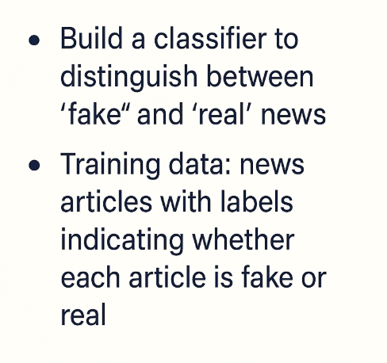
PROJECT OVERVIEW
960 × 480
Search inside image
Notes:
Main Idea: Misinformation spreads rapidly and influences public opinion.
Goal: Can we train a machine to detect fake news using Natural Language Processing? And label them correctly with 0= fake news and 1 = real news

Slide 4
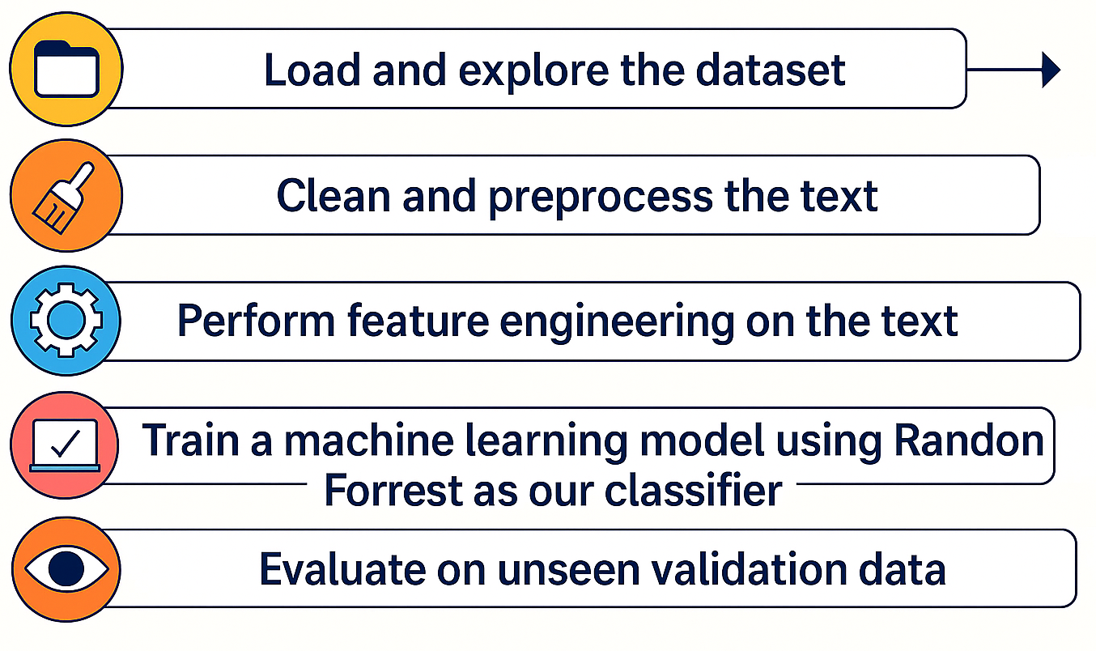
OUR SOLUTION - ML PIPELINE STEPS

Slide 5

DATA SET OVERVIEW
Data Sources:
data.csv: Labeled training data with title, text, subject, date and label features.
validation_data.csv: Unlabeled test set for predictions.
Label Meaning:
0 = Fake news
1 = Real news
Stats: 39,942 rows and 5 columns total

Slide 6
TEXT PREPROCESSING STEPS
Convert
Remove
All text to lowercase
All stop words e.g ‘the’, ‘and’, ’is’
Remove
Apply
special characters and numbers
Stemming using SnowballStemmer
Tokenize
Text into words

Slide 7
FEATURE ENGINEERING
TF-IDF VECTORIZATION
COMBINED TF-IDF Matrix + one-hot encoded subject into final features
Max features: 5000
N-gram range: (1,2)
One-Hot Encoding

Slide 8
MODEL TRAINING
Model Used: RandomForestClassifier Settings:
n_estimators = 100
max_depth = 25
random_state = 42
n_jobs = -1 (for parallel training)
Why Random Forest?
Robust and interpretable
Handles mixed-type features
Works well with sparse TF-IDF data

Slide 9
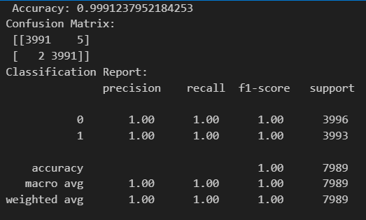
Model Evaluation
Accuracy: 0.9991
Confusion Matrix
Classification Report

Slide 10
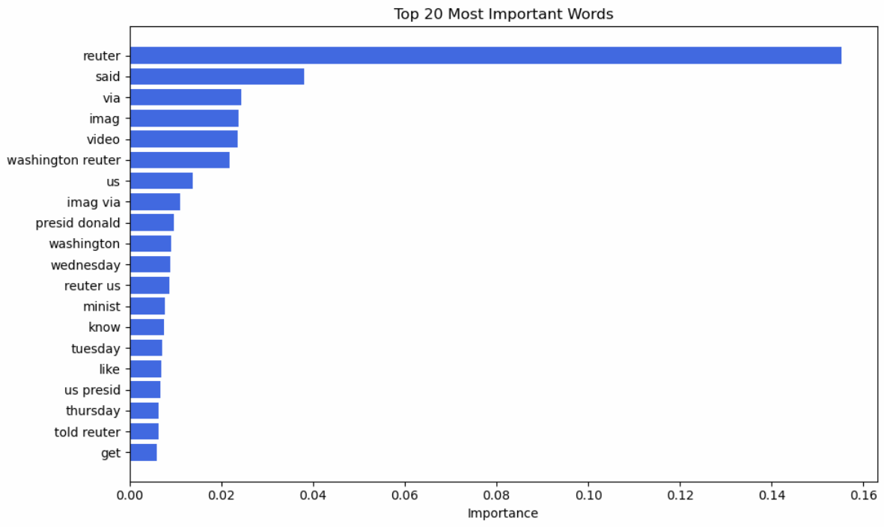
Model Evaluation
Feature Importance

Slide 11
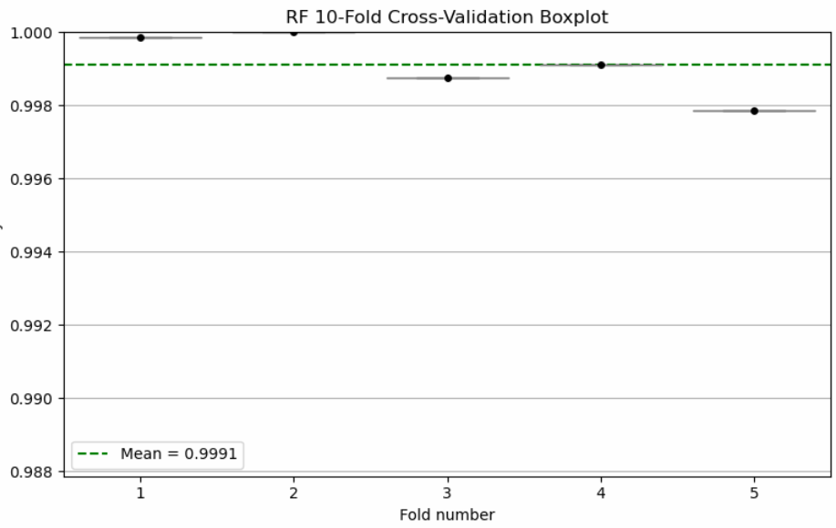
Model Evaluation
5-Fold Cross Validation applied
Removing randome_state parameter (refresh folds each time)
Mean Accuracy: 99.91%
Standard Deviation: 0.00012 (very low dispersion)
Boxplot shows no outliers and consistency results across folds
Stable model and generalizes well

